Slide 1


Noida Institute of Engineering and Technology Greater Noida
ACSE0403B
Operating System
Unit 4
Memory Management System
Mr. Deepak Sharma
Assistant Professor
Department of Cyber Security
B. Tech 4th Semester

Slide 2




Introduction
Noida Institute of Engineering and Technology, Greater Noida
INTRODUCTION
Mr. Deepak Sharma
B.Tech and M.Tech in CSE with 8 Years Teaching Experience
Area of Expertise: Cyber Security, Email Phishing, Cryptanalysis
Attended and Conducted Numerous Workshops.
Published about 5 National and International Papers in reputed Journals.
Attend various FDPs and Webinar.

Slide 3

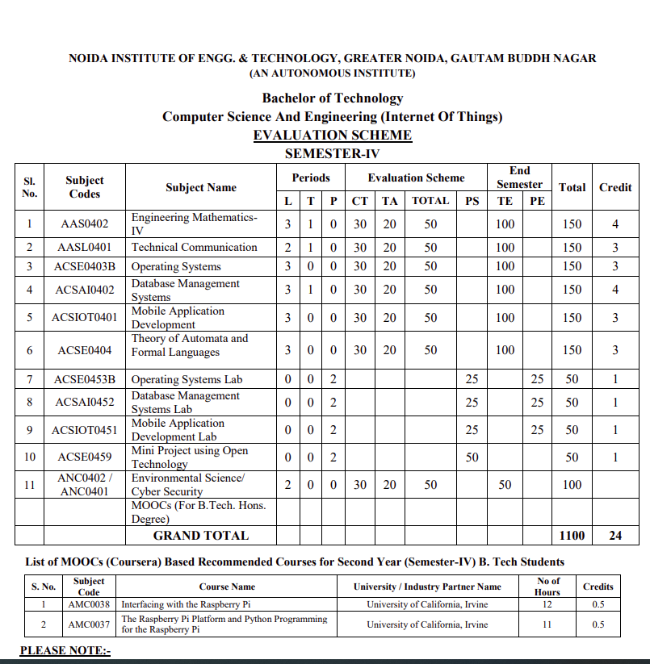
Evaluation Scheme

Slide 4
Content
Memory Allocation
Contiguous
Fixed Partition
Variable partition
Non Contiguous
Paging
Segmentation
Segmentation with paging
Virtual Memory
Demand Paging
Global and local page replacement
Page replacement algorithms
FIFO
LRU
OPTIMAL
Thrashing

Slide 5
Objectives of Unit 4
To understand memory management functions such as allocation of memory to the processes, de-allocate memory from the processes and implement allocation strategies such as First Fit, Best Fit and Worst Fit.
To understand the virtual memory concepts and evaluate the performance of virtual memory with the help of effective memory access time.
To understand the demand paging concept and calculate number of page fault using page replacement algorithms such as FIFO, LRU, and Optimal Page Replacement algorithm.

Slide 6
Course Outcome of Unit 4
At the end of semester, students will be able to
CO4: understand and implement various memory allocation schemes such as contiguous and non-contiguous.

Slide 7
CO-PO Mapping
OPERATING SYSTEM(KCS-401)
CODE | PO1 | PO2 | PO3 | PO4 | PO5 | PO6 | PO7 | PO8 | PO9 | PO10 | PO11 | PO12
KCS401.4 | 3 | 2 | 2 | 3 | 1 | 2 | 2 | - | 2 | - | 2 | 3

Slide 8
CO- PSO Mapping
Course Outcomes | Program Specific Outcomes
 | PSO1 | PSO2 | PSO3 | PSO4
KCS401.4 | 2 | 2 | 1 | 2

Slide 9
Prerequisite and Recap
Basic knowledge of computer fundamentals.
Basic knowledge of computer organization.
Memory hierarchy
Cache Organization
Interrupt
Registers
Associative memory

Slide 10
Topic Mapping with Course Outcome
Course Outcome | Topics
 | Module 1 | Module 2 |  | Module 3 |  | Module 4
 | Memory Allocation | Virtual Memory | Demand Paging | Global and local page replacement | Page replacement algorithms | Thrashing
KCS401.4 | 3 | 2 | 2 | 2 | 2 | 1

Slide 11
Memory Allocation(CO4)
Memory Allocation
Contiguous
Fixed Partition
Dynamic Partition
Non Contiguous
Paging
Segmentation
Segmentation with paging

Slide 12
Memory Allocation(CO4)
Topic Objective: To understand memory allocation schemes
One of the major functions of OS is memory management.
The OS controls the allocation/de-allocation of physical memory.
It keeps track of memory occupancy, loading of programs into free memory space, getting the memory occupied by a process when the process terminates, dynamic allocation/de-allocation of memory to executing process.

Slide 13
Contiguous Memory Allocation(CO4)
Topic objective: To understand the contiguous memory allocation and its type.
In this allocation, a memory resident program occupies a single continuous block of physical memory.
The physical memory is partitioned into block of different sizes for accommodating the programs. This partitioning is of two types:
Fixed partitioning
Variable partitioning

Slide 14
Fixed Partitioning(CO4)
Topic Objective: To understand the mechanism of fixed partitioning.
The memory is divided into a fixed number of partitions of different sizes, which may suit the range of usually occurring program sizes. Each partition can accommodate exactly one process. Thus, the degree of multi-programming is fixed.

Slide 15
Implementation of Fixed Partitioning(CO4)
Topic objective: To understand the various steps in implementing the fixed partitioning scheme.
Whenever, a program needs to be loaded, a partition, big enough to accommodate the program, is allocated. Since a program may not exactly fit the allocated partition, some space may be left unoccupied, after loading the program. This space is wasted and it termed as internal fragmentation.
Memory management is implemented using a table called partition description table(PDT).

Slide 16
Advantages of Fixed Partition(CO4)
Topic objective: Analyze the fixed partition scheme from implementation point of view.
The implementation is very easy.
The processing overheads are low

Slide 17
Disadvantages of Fixed Partition(CO4)
Topic objective: Analyze the fixed partition from the point of memory utilization
The degree of multiprogramming is fixed, since the number of partition is fixed.
Suffers from internal fragmentation

Slide 18
Dynamic Partitioning(CO4)
Topic objective: To understand the dynamic partitioning and how we remove the limitation of fixed partition by implementing it.
This scheme is free of the limitations encountered in the case of fixed partitioning.
Its functions are as follows:
Initially, the entire available memory is treated as a single partition.
The incoming programs, requesting memory allocation, are queued up.

Slide 19
Dynamic Partitioning(CO4)
Topic objective: To understand and implement dynamic partitioning.
A waiting program is loaded, only when a free partition, big enough to fit the program, is available. When a program is loaded, it is allocated a space , exactly equal to its size. The balance unoccupied space, in the allocated partitioned is treated as another free space.

Slide 20
Dynamic Partitioning(CO4)
When a process terminates, it releases the partition occupied. If the released partition is continuous to another free partition, then both the free partitions are clubbed together into a single free partition.

Slide 21
External fragmentation(CO4)
Topic Objective: To elucidate the concept of external fragmentation and removal of it through compaction technique.
When a free partition is too small to accommodate any program, it is called External fragmentation.
External fragmentation refers to the large number of small chunks of free memory that may be scattered all over the physical memory and individually each of the chunks may not be big enough to accommodate even the small program.

Slide 22
External fragmentation(CO4)
However, if joined together, the total free space, thus resulted, may be big enough to accommodate some more programs that may be waiting for loading.
Compaction is a technique, by which the resident programs are re-located in such a way that the small chunks of free are made contiguous to each other and clubbed together into a single free partition, that may be big enough to accommodate Some more programs. But the compaction has very high processing overheads.

Slide 23
Daily Quiz for Module 1 (Memory Allocation)
For formative assessment 1 (10 questions through Google Quiz)
https://docs.google.com/forms/d/e/1FAIpQLSc4Yh7qmuGaZPe5TGGoKS3CQY62nIJniPLt-RvbdiF5hc64TQ/viewform?usp=sf_link

Slide 24
Different Strategy for Partition Allocation(CO4)
Topic objective: To explore the following allocation strategies and its implementation.
There are three strategies:
First Fit
Best Fit
Worst Fit

Slide 25
First Fit(CO4)
Topic Objective: To analyze its merit and demerit.
This refers to the allocation of the first encountered partition that may be big enough to accommodate the program being loaded. This algorithm works both for fixed as well as variable partition allocation.
Advantage: search time is small
Disadvantage: The memory loss, on account of fragmentation, is likely to be high.

Slide 26
Best Fit(CO4)
Topic objective: To analyze the merits and demerits of Best fit allocation strategy.
It refers to the allocation of the smallest available free partition that may be big enough to accommodate the program being loaded. This algorithms also works for both fixed partition and variable partition.
Advantage: The memory loss, on account of fragmentation will be lesser than in the case of first fit.
Disadvantage: Search time will be larger, as compared to first fit.

Slide 27
Worst Fit(CO4)
Topic objective: To analyze the merits and demerits of worst fit allocation strategy.
It refers to the allocation of the largest partition out of the ones which are available, which may be bigger enough to accommodate the program.
The sprit behind this scheme is that the balance space, left in the allocated partition, after loading program, may be big enough to load another small program; and in that eventually, memory loss due to fragmentation may be lower than first fit. Search time in this scheme would be of the same order as in the case of Best Fit.

Slide 28
Worst Fit(CO4)
Advantage: It is expected to provide a smaller memory loss on account of fragmentation.
Disadvantage: Search time is larger than first fit. It is same as in the case of Best Fit.
This algorithm is designed only for variable-partition allocation.
By mistake if used along with fixed partition, the results will be suicidal.

Slide 29
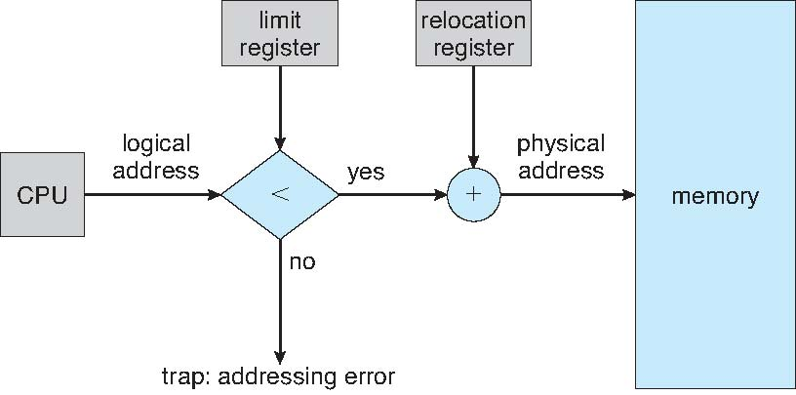
Memory protection in contiguous memory allocation(CO4)
Topic objective: To implement security for protecting the data from address space.
If (Logical address L < limit register Value M)
Physical address P=Logical address L + Relocation value R;
else
Raise Exception: Invalid Address

Slide 30
Non-Contiguous Memory Allocation(CO4)
Topic Objective: To understand and implement the non-contiguous memory allocation scheme.
It offers the following advantages over contiguous memory allocation:
Permits sharing of code and data amongst processes.
There is no external fragmentation of physical memory.
Supports virtual memory concepts.

Slide 31
Non-Contiguous Memory Allocation(CO4)
Topic objective: To understand the implementation of non contiguous memory allocation.
It involves a complex implementation and involves additional costs in terms of memory and processing.
It can be implemented by the concept of:
Paging
Segmentation
Segmentation with paging

Slide 32
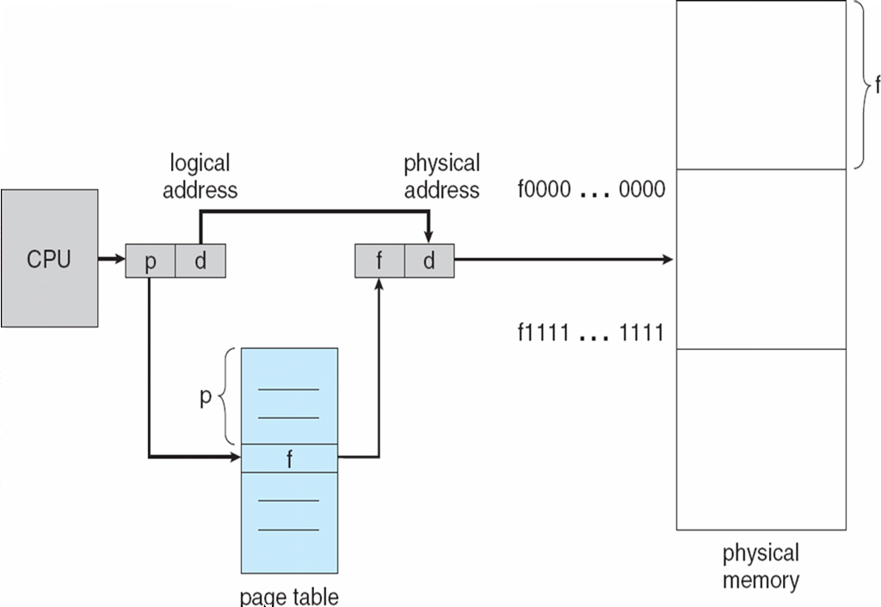
Paging(CO4)
Topic Objective: To explain the paging hardware with the help of following diagram

Slide 33
Paging(CO4)
Topic Objective: To understand the paging mechanism and how logical address is translated into physical address in this mechanism
It permits physical address space of a process to be non-contiguous.
The logical address space of a process is divided into blocks of fixed size called Pages.
Also, the physical memory is divided into blocks of fixed sizes called Frames.
In the system, the page and frame will be of same size.

Slide 34
Paging(CO4)
The size is of the order of 512 bytes to a few MB.
Whenever, a process is to be executed, its page are moved from secondary storage(Hard disk) to the available frames in physical memory(RAM).
The information about frame number, in which a page is resident, is entered in page table. The page table is indexed by page number.

Slide 35
Translation of Logical address into physical address(CO4)
For a ‘m’ bit processor, the logical address will be m bits long.
Let the page size be 2^{n} bytes.
Then lower order n bits of a logical address (L) will represent page offset(d) and the higher order m-n bits will represent the page number (p).
Then page number p=L/2^{n}
And page offset d=L%2^{n}

Slide 36
Translation of Logical address into physical address
Let f be the frame number that holds the page referenced by logical address (L).
Then f can be obtained by indexing into page table, by using page number p as index
f=page-table[p].
Corresponding physical address (P)=f*2^{n} + d
This physical address is fed to MMU to access the memory location, referenced by logical address L.

Slide 37
Internal Fragmentation in Paging(CO4)
Topic Objective: To compute internal fragmentation in paging mechanism.
Since, a program size may not be an exact multiple of the page-size, some space would remain unoccupied in the last page of the process.
The average memory loss, due to internal fragmentation, would be of the order of half page per process. So, larger the page size, larger would be the loss of memory, by internal fragmentation.
Suppose, a system supports a page-size of P bytes.
Then a program of size M bytes, will have an internal fragmentation= P-(M%P) bytes

Slide 38
Limitation of Basic Paging Scheme(CO4)
Topic objective: to compare paging with fixed partitioning scheme.
The effective memory access time increases, since for accessing of an operand, first its frame number has to be accessed. Since, the page table resides in the RAM itself, the effective access time to get an operand will be twice the RAM access time. So, if RAM access time is 100 ns, the effective access time would be 200 ns.
The page table occupies a significant amount of memory

Slide 39
How to Reduce the Effective Access Time in Paging?
Topic Objective: To increase the performance of paging mechanism by introducing the concept of TLB.
TLB (Translation Look-aside Buffer) is page-table cache, which is implemented as a fast associative memory. The associative memory is distinguished by its ability to search for a key, concurrently in all entries in a table.
This property makes the associative memory much faster than conventional RAM. But it is much costlier also.

Slide 40
How to Reduce the Effective Access Time in Paging?
Topic Objective: to compare TLB with RAM.
Due to higher cost, it may not be cost effective to have entire page table in TLB, but a subset of page table, that may be currently active, can be moved to TLB.
Each entry of TLB would contain Page no. of a page and the Frame no. where the page is stored in RAM

Slide 41
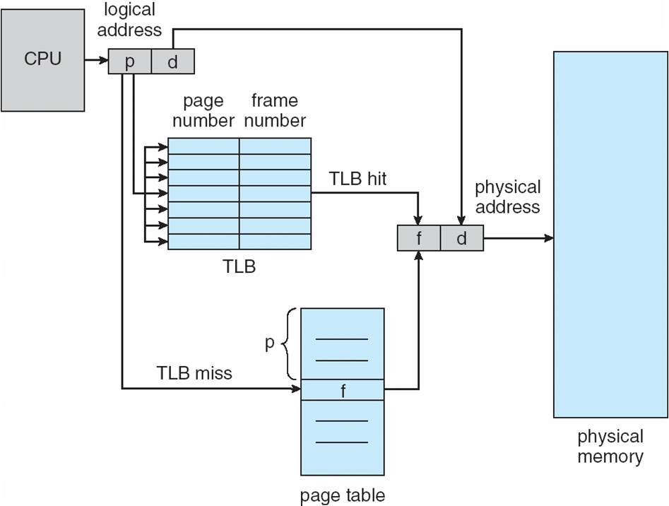
TLB(CO4)
Topic objective: To explain mechanism of TLB Hardware with the help of following diagram.

Slide 42
TLB
Topic Objective: To understand the mechanism of TLB.
Whenever, a logical address is generated, the page no. p of the logical address is fed as a key to the TLB.
The key is searched in parallel in all the entries of TLB.
If the match found for the page no. p, it is termed as TLB hit. The entry, with the matching number contains the frame no., where the page is stored.

Slide 43
TLB
If match not found for the page no., it indicates TLB miss. Then, the frame no. is accessed from the page table. Also, the page table entry is moved to TLB, so that for further references to that page, its frame no. can be accessed from TLB itself.
If TLB is full, then some replacement algorithm can be used to replace one of the existing entries in the TLB.

Slide 44
Improvement in effective memory access time(CO4)
Topic objective: To compute the effective memory access time of cache memory.
TLB Hit ratio=0.9
RAM access time T=100 ns and TLB access time t=20 ns
Effective access time without TLB= 2T=200 ns
Effective access time with TLB
=H*(T + t) + (1-H) * (2*T + t)
=0.9*(100+20) + (1-0.9)*(2*100+20)
=0.9*120+0.1*220=108+22=130 ns
Reduction in effective access time=(200-130)*100/200=35%

Slide 45
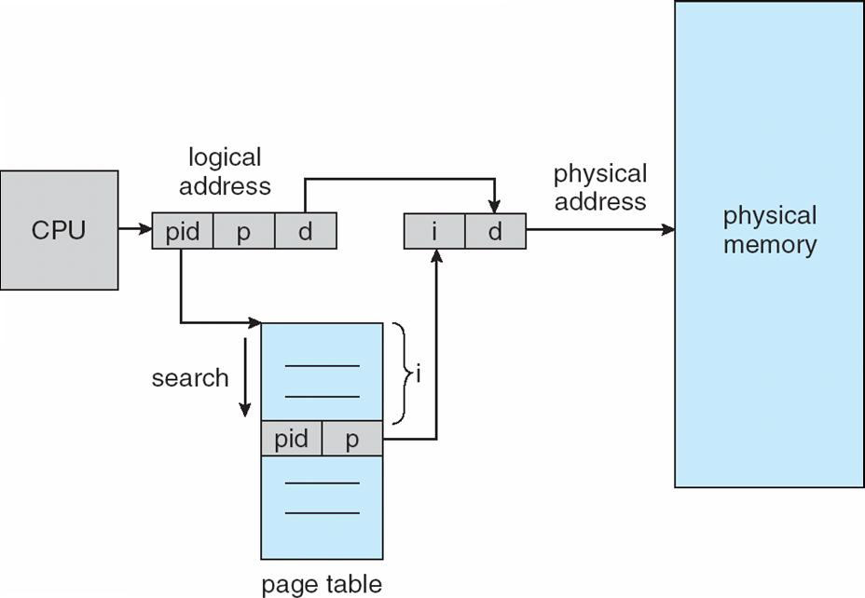
Inverted Page Table(IPT)(CO4)
Topic Objective: To explain the mechanism of IPT with the help of following diagram.

Slide 46
Inverted Page Table(IPT)(CO4)
Topic Objective: To explain the translation of logical address into physical address using IPT
The size of IPT is related to the size of the physical memory, not the size of logical address space. Since, IPT is not process specific and it does not need switching during context switching of the processes. IPT contains process id along with page no. for each frame in the physical memory. IPT is system wide not per process.

Slide 47
Inverted Page Table(IPT)(CO4)
A logical address generated by CPU contains process-id(pid), Page no.(p) and page offset(d). A search is carried out in IPT to find a match for the process id and the page number. The offset of the matching slot in the IPT, gives the frame number, where the desired page is residing. The frame number combined with the offset d, gives the intended physical address.

Slide 48
Advantages of IPT over conventional Page Table
Topic Objective: Comparison of IPT with conventional Page Table.
There is only one page table for all processes, whereas conventional page table is per process.
Its size is related to the size of physical memory available.
Limitations: The search time to match an entry in IPT is very large.
The average search time of IPT can be reduced by combining the IPT with a TLB.

Slide 49
IPT with a TLB(CO4)
Topic Objective: Comparison of IPT with TLB.
Each entry in the TLB would comprise Page number, process-id and its corresponding frame number. The associative memory would permit matching of a process-id and page number pair simultaneously with all the entries in TLB. The desired frame number can then be obtained from the matching entry.

Slide 50
IPT with a TLB(CO4)
Each entry in the TLB would comprise Page number, process-id and its corresponding frame number. The associative memory would permit matching of a process-id and page number pair simultaneously with all the entries in TLB. The desired frame number can then be obtained from the matching entry.

Slide 51
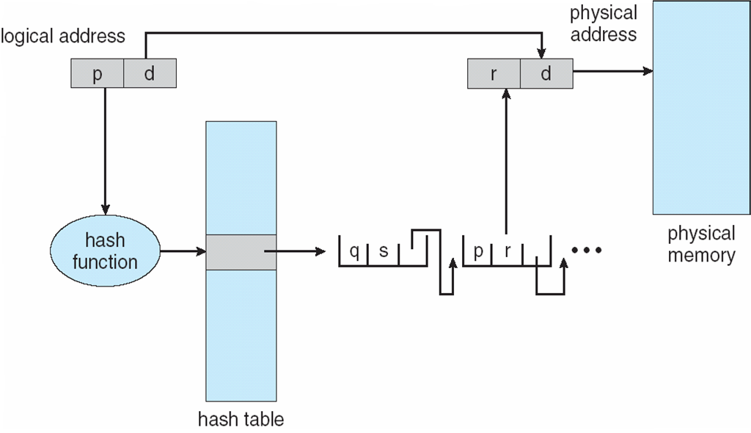
Hashed Page Table(CO4)
Topic Objective: To explain the mechanism of Hashed Page Table with the help of following diagram

Slide 52
Hashed Page Table(CO4)
Topic objective: Translation of logical address into physical address using Hashed Page Table.
A page table is created of length M.
Whenever, logical address is generated, a hashing function is applied to the page number p, to generate an index i.
i=p%M;
The index value i is used to index into the page table. Each entry in the page table is a pointer to a linked list.

Slide 53
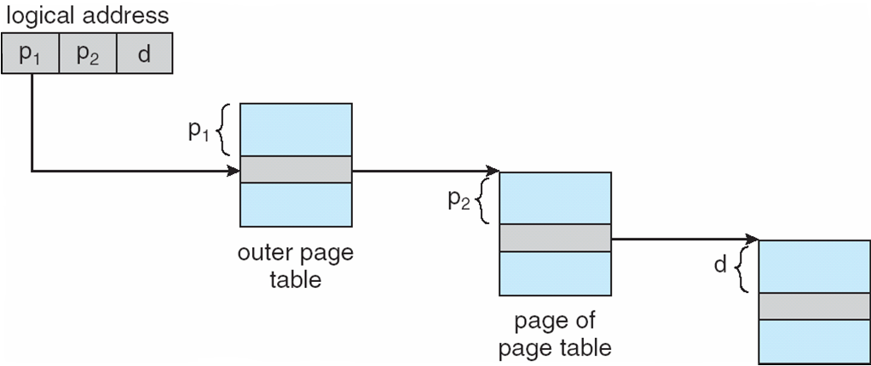
Multi-level Paging(CO4)
Topic Objective: To explain the mechanism of multi-level paging with the help of following diagram

Slide 54
Multi-level Paging(CO4)
Topic Objective: To explain the steps for translating logical address into physical address in multi-level paging scheme.
The page table is split into multiple levels. For example, in a two level page table, a logical address would comprise of the following fields:
(a)Page number p1, for indexing into outer page table.
(b)Page number p2, for indexing into inner page table.
(c)Offset or displacement d that is used to index into the selected frame, to obtain the desired operand

Slide 55
Multi-level Paging(CO4)
The page table is split into multiple levels. For example, in a two level page table, a logical address would comprise of the following fields:
(a)Page number p1, for indexing into outer page table.
(b)Page number p2, for indexing into inner page table.
(c)Offset or displacement d that is used to index into the selected frame, to obtain the desired operand

Slide 56
Advantage of Multi-level Paging(CO4)
Topic objective: To explain the advantages of multi-level paging.
All the inner page tables would not be required to be memory resident simultaneously. Depending upon the size of executing program only a small fraction of the set of inner page tables would need to be memory resident, thus reducing the memory overhead of the page table.

Slide 57
Disadvantage of Multi-level Paging(CO4)
Topic objective: To explain the disadvantage of multi-level paging.
To access an operand, multi-level paging needs some extra memory accesses. For example, in the case of two level paging, an additional memory access is required, that is, to get the base address of inner page table.

Slide 58
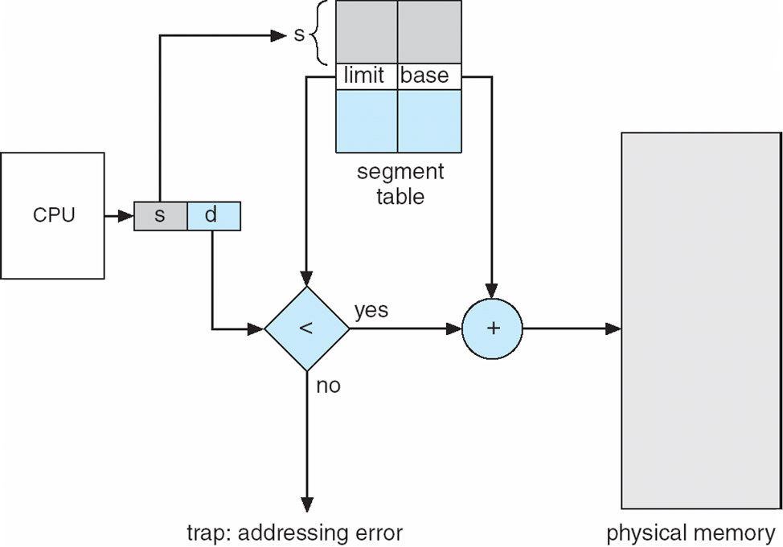
Segmentation(CO4)
Topic objective: To understand segmentation mechanism with the help of following diagram

Slide 59
Segmentation(CO4)
Topic objective: How logical address is translated into physical address in segmentation mechanism.
In segmentation, the physical memory is divided into segments of varying sizes. Each segment is assigned a unique segment number.
The memory management is done through a segment table, which is indexed by segment number. For each segment, it has an entry that provides base address of the segment and size of the segment. The logical address contains segment number ‘s’ and offset within the segment ‘d’

Slide 60
Segmentation(CO4)
Using the segment number, the system obtains base address of the segment. Then it makes a check to determine whether offset is within the segment size or not. If yes then the offset d is valid and physical address is computed by adding the offset to the base address; else it is invalid (error).

Slide 61
Segmentation with paging(CO4)
Topic Objective: To understand and implement the segmentation with paging mechanism.
In this, the logical space is divided into a number of segments of varying sizes and each segment is divided into a number of pages, each of a fixed size.
The memory management is done through a segment table. Each segment has an entry in the table. An entry contains base address of the segment page table and size of the segment page table.

Slide 62
Segmentation with paging(CO4)
The logical address contains segment number, page number in a segment and offset ‘d’ in the page. The segment number s is to access the segment entry in the access the segment page table. So, each segment will have a separate page table. The page number p is used to access the frame number in the page table, provide p<M (size of the segment page table); else it is invalid page number. The frame number ‘f’ is combined with the offset ‘d’ to compute the physical address.

Slide 63
Daily Quiz of Module 2 (Virtual Memory + Demand Paging)
For formative assessment 2
https://docs.google.com/forms/d/e/1FAIpQLSdZ26DWe4bdxawhdBJPrLqSp7EKpV7s0uXjj2yM8SiM8_Bd4g/viewform?usp=sf_link

Slide 64
Virtual Memory(VM) Concept(CO4)
Topic Objective: To understand and implement the virtual memory concepts.
Virtual memory is a technique that permits execution of processes with their code only partially loaded into the physical memory.
This technique takes advantage of the fact that a program tends to have locality of reference and a process code never required in its entirety, at the same time.

Slide 65
Virtual Memory(VM) Concept(CO4)
Virtual memory is a technique that permits execution of processes with their code only partially loaded into the physical memory.
This technique takes advantage of the fact that a program tends to have locality of reference and a process code never required in its entirety, at the same time.

Slide 66
Advantages of Virtual Memory(CO4)
Topic objective: To describe the advantages of using virtual memory concepts.
Programs are not constrained by physical memory size.
Degree of multi programming can be varied over a large range

Slide 67
Implementation of VM(CO4)
Topic objective: Implantation of VM concepts using demand paging and demand segmentation.
It is implemented by demand paging or by demand segmentation.
When a process is swapped-in, the pager loads a set of its pages, which may be predicted to be initially needed by the process into the physical memory.
The secondary memory holds the remaining pages of the process.

Slide 68
Implementation of VM(CO4)
When a process is swapped-in, this bit is set to invalid for all the entries in the page table. When page is loaded into RAM, its frame number is entered and page validity bit is set to valid.
Thus if bit is valid, it indicates that the page is legally from the logical address space of the process and is currently in the RAM.
If it is set to invalid, it indicates that either the page does not belong to the logical address space of the process or it is still not loaded into RAM.

Slide 69
Implementation of VM(CO4)
Whenever, a logical or virtual address is generated, the system operates as follows:
Looks into the page table. If the page validity bit is set to v, it reads the corresponding frame number, adds page offset and determines physical address.
If the page table indicates page invalid, then system reads the page into a free frame. If no free frame is available, it uses a page replacement algorithm to replace an occupied frame.

Slide 70
Implementation of VM(CO4)
In addition to this, system needs the following system tables:
Page Map Table : This table is per process. It indicates whether the page is memory resident or not. It also contains validity bit.
Memory Map Table (Free Frames’ list): This table provides information about the availability of free frames, that can be allocated accommodate new pages. This table is per system.
File Map Table: This table is per process. It provides the disk addresses, where the process pages are stored on the secondary storage.

Slide 71
Demand Paging(CO4)
Topic objective: To explain the types of demand paging.
Pure Demand Paging: All the pages are placed in secondary storage and on demand basis, it is loaded into main memory at execution or run time. At the outset, main memory is empty.
Pre-fetched Demand Paging: In this some of the selective pages are preloaded(before execution starts). Initially some of the pages are in main memory.

Slide 72
Modified/Dirty Bit(CO4)
Topic objective: To understand the concept of modified and dirty bit in the implementation of Virtual Memory Concepts.
It is used to reduce one disk access.
If write operation is performed on the page after loading, then page is modified or dirty.
If page is dirty, first write the dirty page into disk and bring the requested page into main memory.
If the page is clean, no write operation is performed on the page simply replace the page with requested page.

Slide 73
Daily Quiz for Module 3 (Page Replacement Algorithms)
Formative assessment 3 (10 Questions through Google Quiz)
https://docs.google.com/forms/d/e/1FAIpQLScWDSkv8cGZ5T_-M6w0EW3dCe_byh3-_gOhd5uuUHBdGSXV6Q/viewform?usp=sf_link

Slide 74
Global and Local Page Replacement(CO4)
Topic Objective: To understand and Page Replacement Concepts and its types.
Whenever, a process experiences a page fault, if no free frame are available, then the OS gets a currently occupied frame released and allocates the released frame to the page faulting process, for accommodating the new page. If the victim page belongs to the page faulting process itself, it is called local page replacement; else it is called global page replacement. Global page replacement does not focus on the performance of individual processes. It rather focuses on the system performance.

Slide 75
FIFO Page Replacement Algorithm(CO4)
Topic Objective: To implement the FIFO Page Replacement Algorithm.
It replaces the page that has been in the memory for the longest time. One possible implementation is a FIFO (queue) of the existing pages in the memory. Whenever, page fault occurs, the page at the top of the queue is made victim and the new page is put at the tail of the queue.
Reference String: It refers to the sequence of page numbers referenced by a program during its execution.
Page number = Quotient (Logical Address/Page Size), if logical address =0745 and page size =100 bytes, then page no=0745/100=7

Slide 76
Advantages and Disadvantages of FIFO(CO4)
Topic Objective: To explain the merit and demerit of FIFO Page Replacement Algorithm.
Advantage: Implementation is fairly simple
Limitation: This algorithm does not take into account the current usages of pages and may often eject some pages that may be currently active. Such pages would need to be moved in frames again, in near future.
Also, if the system has global page replacement, then the program having largest number of allocated pages would have higher page fault rate, since the probability of oldest page, belonging to this program would be very high. This phenomena is called Belady’s Anomaly and it defies intuition.

Slide 77

















No. of Faults using FIFO(CO4)
7
7
7
2
2
2
2
4
4
4
0
0
0
0
0
0
0
7
7
7
No. of Frames
0
0
0
0
3
3
3
2
2
2
2
2
1
1
1
1
1
0
0
1
1
1
1
0
0
0
3
3
3
3
3
2
2
2
2
2
1
Status
F
F
F
F
H
F
F
F
F
F
F
H
H
F
F
H
H
F
F
F

Slide 78
No. of Faults using FIFO(CO4)
Total no. of page fault or misses =15
Total no. of Hits = 5
Hit ratio= 5/20=0.25
Page fault % = (15/20)*100=75%

Slide 79
LRU Page Replacement Algorithm(CO4)
Topic Objective: To implement the LRU Page Replacement Algorithm.
It replaces the page which has been used least recently. So, while choosing a resident page for replacement, the algorithm takes into account its current usage. It is presumed that a page that has been used least recently, would be the one that would be least likely to be accessed in the near future. One implementation of this algorithm could be by using a stack. Whenever, a new page is brought in, it is placed at the top of stack. Also, whenever, a resident page is accessed, it is removed from its current position and moved to the top of the stack. Whenever, a page is to be replaced, victim page is chosen from the bottom of the stack.

Slide 80
LRU Page Replacement Algorithm(CO4)
Topic Objective: To explain the advantages and disadvantages of LRU Page Replacement Algorithm.
Advantage: While selecting a resident page for replacement, it takes into consideration the current usage of a page. This algorithm is free from Belady’s Anomaly.
Limitations: The algorithm has a lot of processing overheads, which are needed to keep track of least recently used

Slide 81
No. of Faults using LRU(CO4)
No. of Frames 3
7
7
7
2
2
2
2
4
4
4
0
0
0
1
1
1
1
1
1
1
0
0
0
0
0
0
0
0
3
3
3
3
3
3
0
0
0
0
0
1
1
1
3
3
3
2
2
2
2
2
2
2
2
2
7
7
7
Status
F
F
F
F
H
F
H
F
F
F
F
H
H
F
H
F
H
F
H
H

Slide 82
No. of Faults using LRU(CO4)
Total no. of page fault or misses =12
Total no. of Hits = 8
Hit ratio= 8/20=0.40
Page fault % = (12/20)*100=60%

Slide 83
Optimal Page Replacement Algorithm(CO4)
Topic Objective: To implement the Optimal Page Replacement Algorithm.
In its ideal form, this algorithm should replace a page, which is to be referenced in the most distant future. Since, it requires knowledge of future, its ideal form is not implementable. The significance of this algorithm is only theoretical. It is used to compare performance of an implementable algorithm with that of the optimal.

Slide 84
Optimal Page Replacement Algorithm(CO4)
Topic Objective: To compare Optimal Page Replacement Algorithm with FIFO and LRU.
Optimal algorithm appears to be best in term of number of page faults, but it is not feasible to implement this algorithm since the algorithm requires the knowledge of future. Out of FIFO and LRU, the LRU is better, since it takes into consideration the current usage of a page whenever a resident page is considered for replacement. The page, which has been least recently used is chosen for replacement.

Slide 85
No. of Faults using Optimal Page Replacement(CO4)
No. of Frames 3
7
7
7
2
2
2
2
2
2
2
2
2
2
2
2
2
2
7
7
7
0
0
0
0
0
0
4
4
4
0
0
0
0
0
0
0
0
0
0
1
1
1
3
3
3
3
3
3
3
3
1
1
1
1
1
1
1
Status
F
F
F
F
H
F
H
F
H
H
F
H
H
F
H
H
H
F
H
H

Slide 86
No. of Faults using Optimal Page Replacement(CO4)
Total no. of page fault or misses =09
Total no. of Hits = 11
Hit ratio= 11/20=0.55
Page fault % = (9/20)*100=45%

Slide 87
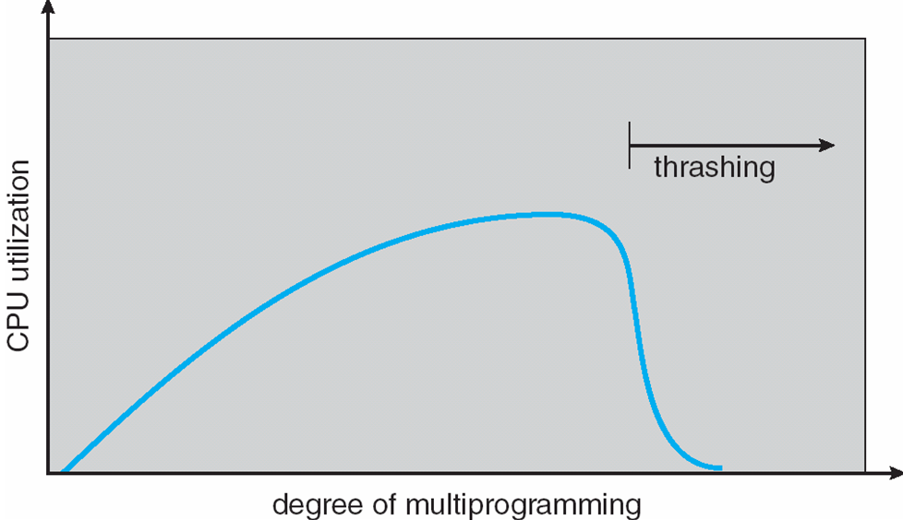
Thrashing(CO4)
Topic objective: To understand the concept of thrashing and how it impacts adversely on the performance of the system
As we increase the degree of multiprogramming CPU utilization increases to a certain limit, after that drastically decreases that is called thrashing.

Slide 88
Working Set Model(CO4)
Topic objective: Removal of thrashing with the help of working set model.
It is one of the solution of thrashing.
It is based on assumption of locality of reference.
It uses ∆, working set window
Idea is to examine recent working set window page references
If a page is in active use, it will be in working set window and if it is no longer being used it will be dropped from working set

Slide 89
Locality of Reference of a Process(Spatial and Temporal)
Topic objective: To understand the locality of reference of a process and its type.
At any time, during its execution, a process will be accessing only a small subset of logical address space. This subset of the logical address space is called its current locality of references. The current locality keeps shifting. It also keeps varying in size. Whenever, a page forming part of the current locality is not found in the memory, it will cause a page fault. So when a process moves from one locality to another, it will get the new pages into memory through page faulting.

Slide 90
Page Fault Frequency(CO4)
Topic Objective: To remove the thrashing with the concept of Page Fault Frequency.
At any time, during its execution, a process will be accessing only a small subset of logical address space. This subset of the logical address space is called its current locality of references. The current locality keeps shifting. It also keeps varying in size. Whenever, a page forming part of the current locality is not found in the memory, it will cause a page fault. So when a process moves from one locality to another, it will get the new pages into memory through page faulting.

Slide 91
Page Fault Frequency(CO4)
The PFF Algorithm may be implemented as follows:
Whenever, a process is having a page fault, the OS computes the time elapsed since its last page fault. If the interval is lower than the critical value T (it indicates a PFF higher than critical), then a new frame is allocated to the process.
However, if the interval is higher than T, then frame assigned to the process, whose reference bit and written –into bit are found to be clear, is replaced by new page.
The OS sweeps and frees those frames that have not been referenced since last sweep. These frames are added to the pool of free pages. The referenced bits of the remaining resident pages are reset.

Slide 92
Faculty Video Links, YouTube & NPTEL Video Links and Online Courses Details
YouTube/other Video Links
https://www.youtube.com/watch?v=LLhgnIYpQaI
https://www.youtube.com/playlist?list=PLmXKhU9FNesSFvj6gASuWmQd23Ul5omtD
https://www.youtube.com/watch?v=xAvC-MJ_Sz8
https://nptel.ac.in/courses/106108101

Slide 93
Daily Quiz for Module 4 (Thrashing)
For formative assessment 4 (10 Questions through Google Quiz)
https://docs.google.com/forms/d/e/1FAIpQLSdsUDs1JSLT_04DIWS7UoSn4CyswTRFbUVrDV3Yn2AmYA6quA/viewform?usp=sf_link

Slide 94
MCQ
100 MCQ on the below link
http://www.nietcampus.com/Manage/QuestionPaper/

Slide 95
Weekly Assignment
Name the common strategies to select a free hole from a set of available holes.
Explain Compaction.
Define Virtual Memory.
Name the various page replacement algorithms used for page replacement.

Slide 96

Old Question Papers

Slide 97
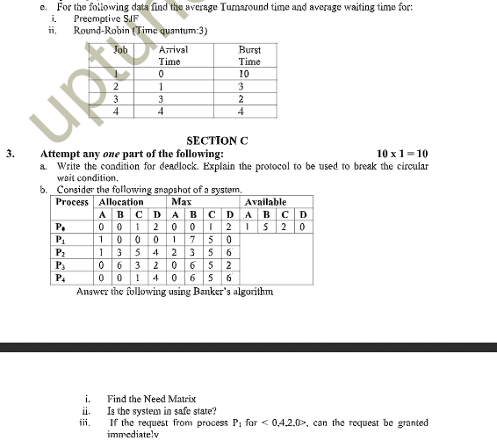
Old Question Papers

Slide 98
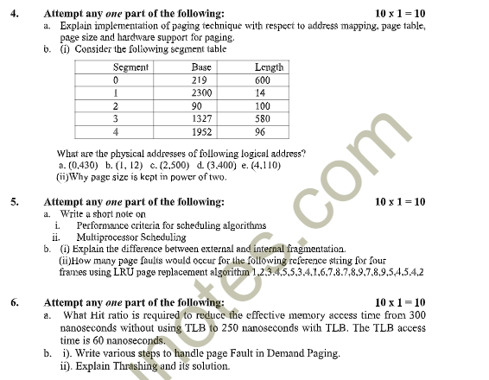
Old Question Papers

Slide 99
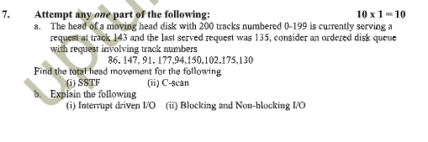
Old Question Papers

Slide 100
Expected Questions for University Exam
Explain paging. Describe how logical address is translated to physical address in a paged system.
Explain thrashing. State the cause of thrashing and discuss its solution
Differentiate between internal fragmentation and external fragmentation.
Define Belady’s anomaly.
Differentiate between the paging and segmentation.
When do page faults occur? Describe in detail the actions taken by the operating system when a page faults occur.
7. Consider the following reference string 1,3,2,4,0,1,5,6,0,1,2,3,0,5,6,4,2,1,3,2.7,3,2.
How many page faults will occur for:
FIFO Page Replacement
Optimal Page Replacement
LRU Page Replacement
Assuming three and four frames (initially empty)
Operating System Concets

Slide 101
Summary
In this module, we have studied the following:
Memory Allocation
Contiguous
Fixed Partition
Variable partiton
Non Contiguous
Paging
Segmentation
Segmentation with paging
Virtual Memory
Demand Paging
Global and local page replacement
Page replacement algorithms
FIFO
LRU
OPTIMAL
Thrashing
Operating System Concets

Slide 102
References
Books :
Silberschatz, Galvin and Gagne, “Operating Systems Concepts”, Wiley
SibsankarHalder and Alex A Aravind, “Operating Systems”, Pearson Education
Harvey M Dietel, “ An Introduction to Operating System”, Pearson Education
D M Dhamdhere, “Operating Systems : A Concept basedApproach”, McGraw Hill.
Charles Crowley, “Operating Systems: A Design-Oriented Approach”, Tata McGraw Hill Education”.
Stuart E. Madnick & John J. Donovan, “ Operating Systems”, Tata McGraw
Operating System Concets

